Slide 1
Hospital project
Aug.15.2018

Slide 2
Data Description
In total: 15495
Count in different type:
Surgeon ID | 53
Anesthesiologist ID | 51
Scrub ID | 115
Circulator ID | 98
First Assistant ID | 227
Second Assistant ID | 117

Slide 3
Data Description
NA distribution:
Scrub ID | 53
First Assistant ID | 93
Second Assistant ID | 679

Slide 4
Data Distribution
Surgeon : 53
Number : surgeon ID
Size: times of records
No.876 surgeon did 1190 surgeries ranking the first.

Slide 5
Data Distribution
Anesthesiologist: 51
Number : Anesthesiologist ID
Size : times of records
No.465 Anesthesiologist did 1106 surgeries, ranking first here.

Slide 6
Our methods
Method A: Calculate the time interval, get the team that cost the least time and the team has made progress
Method B: Design the social network, get the modularity that people cooperated more times than others
Then combine the method A and method B to get the best combination of teams

Slide 7
Method A

Slide 8
Data Distribution
Time between Room Setup Start Time and Patient out of Room which we named Room Occupied Time
Time between Patient in Room Time Patient out of Room which we named Time for Patient
Time between Anesthesia Start Time and Induction End which we named Anesthesia time
Time between Procedure Start and Procedure End which we named Procedure time
All in minutes

Slide 9
Room occupied time
Time for patient
Anesthesia time
Procedure time

Slide 10
Time descriptive analysis
 | Room Occupied Time | Time for Patient | Anesthesia Time | Procedure Time
mean | 158.02659 | 128.438942 | 18.138669 | 79.634448
std | 39.94862 | 26.368209 | 7.562446 | 20.494402
min | 68.00000 | 56.000000 | 0.000000 | 0.000000
25% | 135.00000 | 111.000000 | 13.000000 | 66.000000
50% | 153.00000 | 125.000000 | 17.000000 | 77.000000
75% | 174.00000 | 143.000000 | 22.000000 | 91.000000
max | 1132.00000 | 385.000000 | 141.000000 | 314.000000

Slide 11
Until now
We can conclude from the time distributions that we can’t imagine the records here are of the same kind of surgeries because the time they cost differed a lot from each other.
So in the following researches we will focused on the surgeons instead of every records to avoid the differences between different surgeries.

Slide 12
Method B

Slide 13
Team Analysis
Teams in total(including all six roles, NA value substituted by 999):
Count: 15495
Unique: 10477
Most frequent team:
Surgeon ID:647 Anesthesiologist ID: 465 Scrub ID:998
Circulator ID :277 First Assistant ID :510 Second Assistant ID:991
Frequency: 31

Slide 14
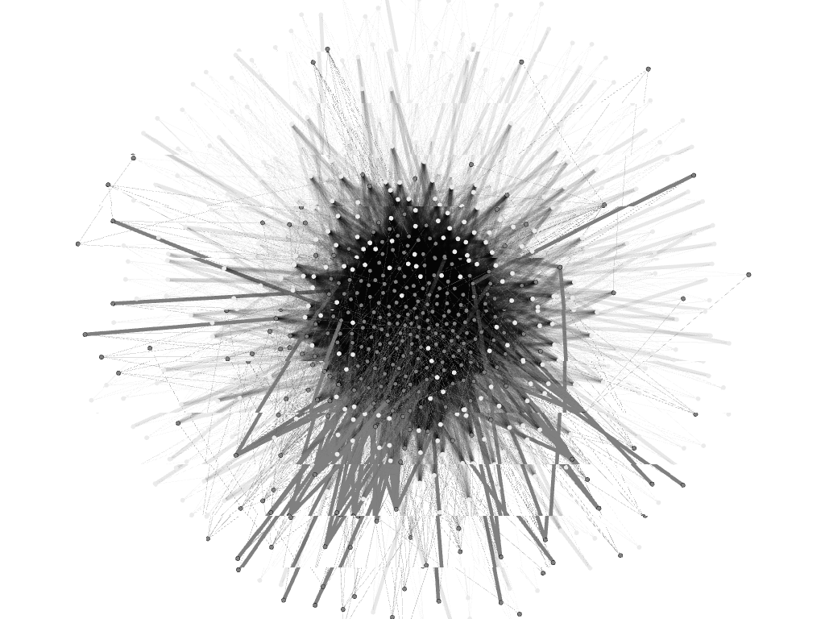
Social Network Analysis
Nodes : different roles
Edges : in the same record
Weight : the times they cooperate

Slide 15
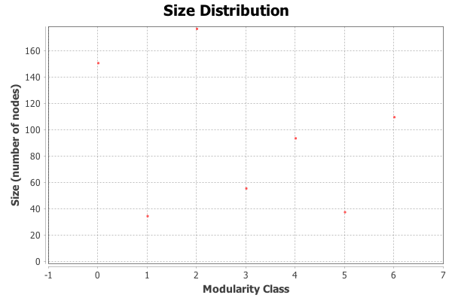
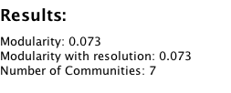
Modularity Results

Slide 16
Modularity results
Cluster No.2 has most people, while Cluster No.1 has the least.

Slide 17
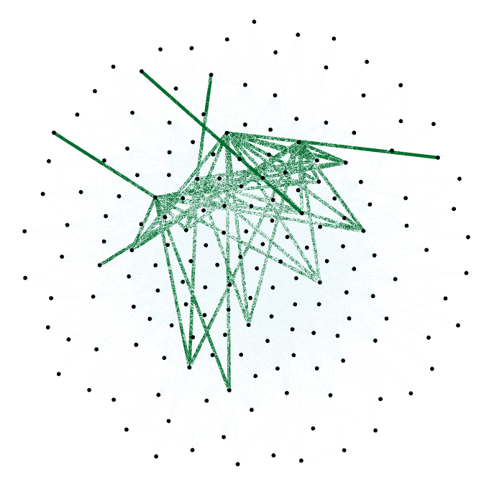
Modularity results

Slide 18
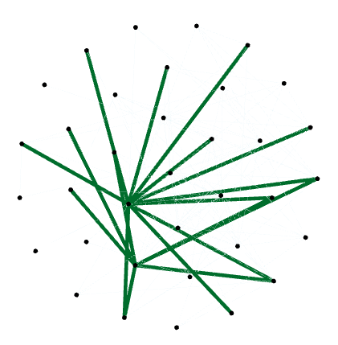
Modularity results

Slide 19
Combined to calculate the best team

Slide 20
Best Team for Each Day
Using genetic algorithm to generate the best team for each day
Define the cost to be the times of cooperation
Calculate the times of original combination
compare the original combinations with the new one

Slide 21
New times versus mean of Original combinations
Orange: Mean of original value
Blue: New Value

Slide 22
Distribution of Gap
Biggest : 1994
Smallest : 0
Median : 913

